Slide 1
“Online Fake Review Detection using Supervised Machine Learning and BERT Model”
Team 11
20101301
Alina Hasan
Faculty
Annajiat Alim Rasel
ST & RA
Md Farhadul Islam
Md Sabbir Hossain
A Discussion on:
By Abrar Qadir Mir, Furqan Yaqub Khan
& Mohammad Ahsan Chishti

Slide 2
Introduction
Detection is either Manual or Automatic
Manual: Expensive, Time-consuming & Subject to Error
Automated Detection uses Machine Learning
NLP creates Review Features
BERT performs NLP Tasks

Slide 3
Background
ML Algorithms Learn Patterns & Improve over Time
Supervised ML Requires Labels & Data
Commonly used Supervised Classifiers: SVM, Naive Bayes, Random Forest…

Slide 4
Dataset
Hotel Review Dataset: 1600 Reviews on 20 Different Hotels
Restaurant Review Dataset: 20 Fake Reviews for 10 Famous Restaurants
Doctor Review Dataset: 356 Fake Reviews
Amazon Dataset: 21 000 Reviews with 10 500 Listed Fake

Slide 5
…
Methodology
Dataset Collection
BERT processes Dataset:
I. Requires Metadata
II. Process Tokens into Vectors
III. Produces Vector sequence or Word Embeddings
Word embeddings fed to each classifier:
Training:Testing = 80:20
Confusion matrix for evaluation
Best performing classifier deployed
Dataset
BERT
Word Embeddings
Classifier
Evaluation
Selection

Slide 6
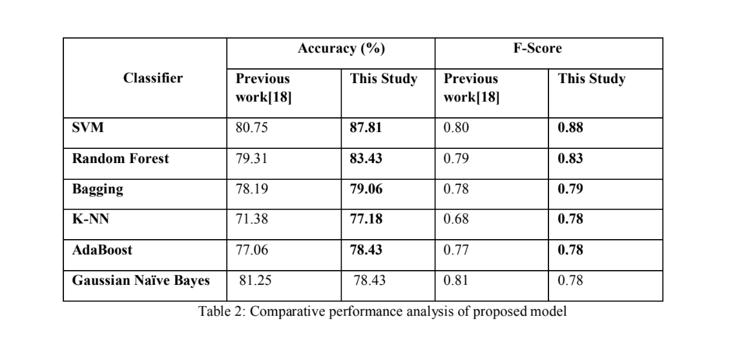
Evaluation
The proposed system was tested using six different classifiers.
The hotel dataset was used to test the different classifiers. And as a result, the results the SVM classifier model outperforms others with an 87.81% accuracy rate.

Slide 7
Conclusion
&
Future Work
Fake reviews reduce the authenticity of a business, raising & plunging store evaluations.
Thus, the removal of these has become an essential line of research. Utilizing BERT has improved the performance of ML detection models with SVM scoring the highest.
However, this approach only considered the text content of reviews and not their sentiment. Future work may involve considering the behavioral features of reviewers to enhance the performance of the approach. Additionally, using neural network models may also be beneficial for detecting fake reviews for large datasets.

